Slide 2
Build Code Lab UWP Development 1: Building an Adaptive UI
L724
Andy Wigley @andy_wigley
Mike Taulty @mtaulty

Slide 3
Proctors
Proctors are here to help you!
Raise your hand if you need any assistance
Jason Short DX
Juliette Weiss Design
Kelsey Huebner DX
Cory Hendrixson Windows Development Group
Travis Wilson Windows Development Group
Vishwac Sena Kannan Windows Development Group
Francis Zhou Inking
Dorrene Brown Cortana
Shawn Henry Windows Development Group
Paul Rambo Windows Development Group

Slide 4
UWP Lab Modules
1
Building an Adaptive UI
2
More Personal Computing
(Follows on from Module 1, but can be done independently)
3
Building Connected Mobile Experiences: Cloud and App to App (Follows on from Module 2, but can be done independently)
Notes:
“As a follow-on to this lab, we also have the Azure IoT lab. In that, you’ll learn how to use the Raspberry Pi to send sensor data to IoT Hub and process it using other Azure IoT services.
If you are interested in the underlying IO and other capabilities on devices like the Raspberry Pi, or want to explore more with Azure and devices, we also have the Open Hack in this same room, starting on Day 2.”

Slide 5
UWP Code Lab Related Sessions Wednesday 03/30
11:30 – 12:30 | Universal App Model Overview: What’s New in the UWP App Model Marriott 9
14:00 – 15:00 | What’s New in Windows UI/UX for Universal Windows Apps Moscone 2004
15:30 – 16:30 | Bringing Existing Desktop Applications to UWP Moscone 2004
17:00 – 18:00 | Windows Store and Dev Center Overview: New Capabilities for Helping Developers Succeed Moscone 2001

Slide 6
UWP Code Lab Related Sessions Thursday 03/31
11:30 – 12:30 | What’s new in Visual Studio for UWP Developers Marriott 7
14:00 – 15:00 | Pen and Inking: Inking at the Speed of Thought Marriott 8
15:30 – 16:30 | Creating Beautiful UX in a Real World App with Visuals, Animations and Effects Moscone 2001
17:00 – 18:00 | Building Great UWP Apps for Xbox Marriott 8 | Cortana: Step-by-Step on How to Teach Cortana to Proactively Engage with your App Moscone 2005
18:30 – 19:30

Slide 7
UWP Code Lab Related Sessions Friday 04/01
09:00 – 10:00 | Universal Windows Application Lifecycle: From Activation to Background Execution, Multitasking and Extended Execution Moscone 2005
10:30 – 11:30 | HoloLens: Building UWP 2D Apps Marriott 9
12:30 – 13:30
14:00 – 15:00 | Continuum for phone: Optimizing Windows apps across screens Moscone 2001

Slide 8
In this module…

Slide 9
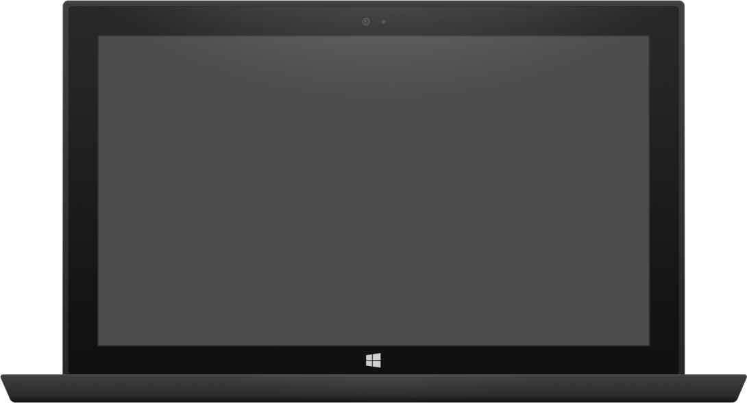
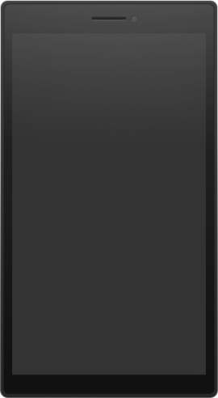
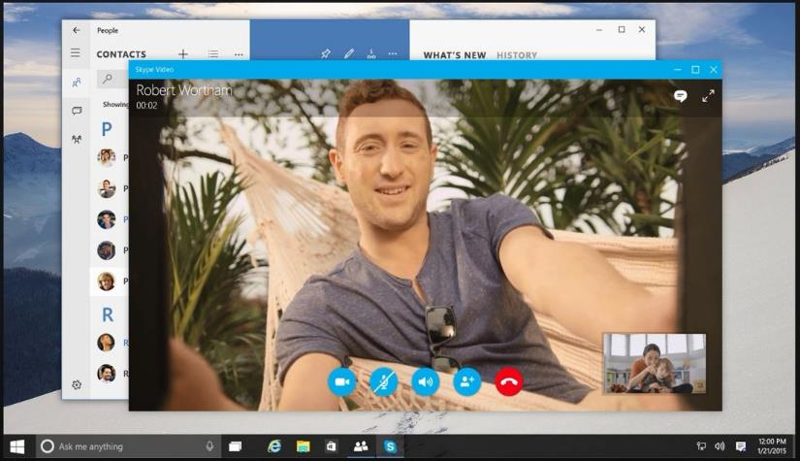
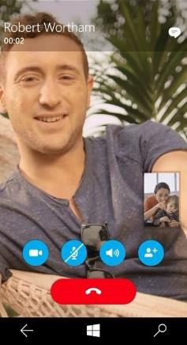
Adaptive UI
Build a page that adapts to different screen sizes and orientations
Use Visual States and Adaptive Triggers to change layout
Use RelativePanel to position blocks of content relative to peers, re-positioning in different visual states
Tablet (landscape) / Desktop
Phone (portrait)
Notes:
In many cases, you will use the same display but adapt it using Visual States and – a new feature in UWP XAML - Adaptive Triggers to move content around, or to show/hide bits of content. Another new control, RelativePanel, is great for repositioning content under the control of Visual States – for example, repositioning the ‘End Call’ button underneath the other control buttons on the phone display shown here.

Slide 10
Planning your design
5”
8”
13”
Phone
Viewing Distance: 16.3”
Tablets and 2 in 1
Viewing Distance:
20”
Small and Large Laptops
Viewing Distance:
24.5”
Small and Large Desktop Monitors
Viewing Distance:
28”
TV
Viewing Distance:
84”
Notes:
When you think of the broad range of screen sizes available across all Windows 10 devices, from 4.5” phones up to the 84” Surface Hub, it can seem daunting to create an adaptive UI that will work well across all of these.
Our advice is to target a few key scenarios:
5” phone in portrait
8” tablet in portrait and landscape
13” laptop/PC in landscape
If you focus on these key targets, and use adaptive layout techniques such as Grid layout and controls that can wrap and flow output such as the TextBlock with Wrapping set to true, then you should find that you will end up with good results across all the targeted devices and also on those intermediaries.
You can then target additional screens such as large monitors, Surface Hub or Xbox if it makes sense for your app.

Slide 11
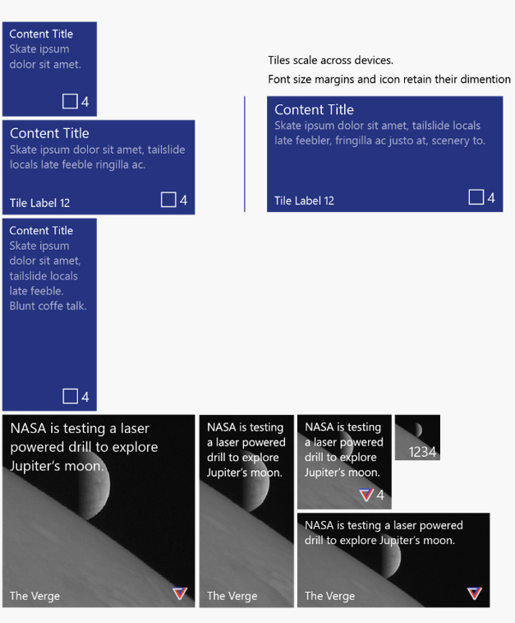
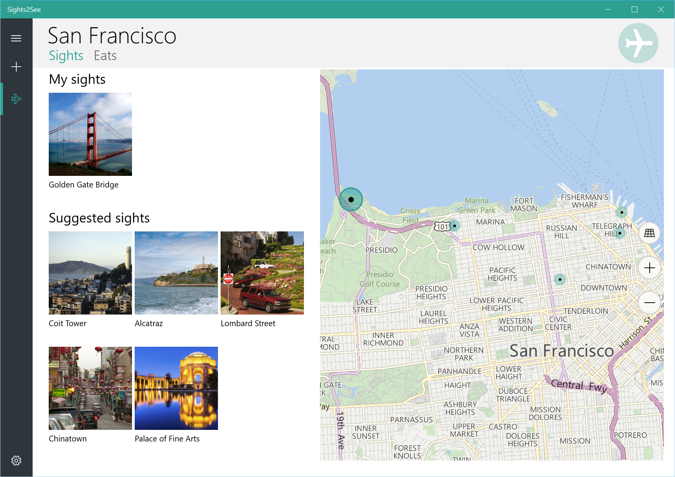
Also… Live Tiles and Maps

Slide 12
Getting setup…

Slide 13
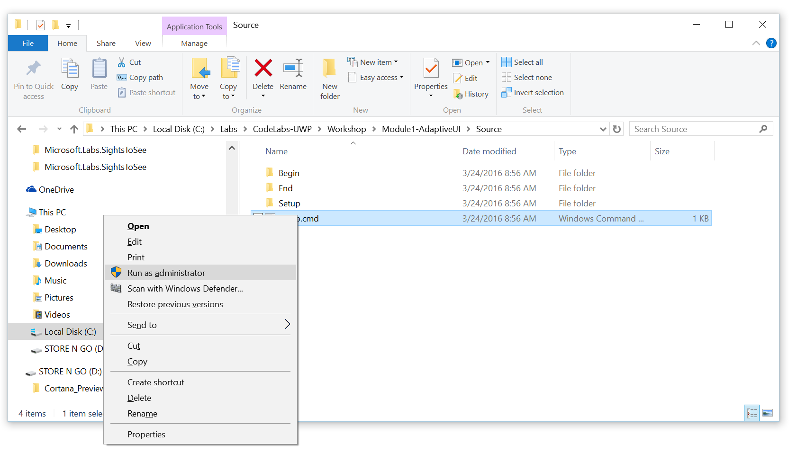
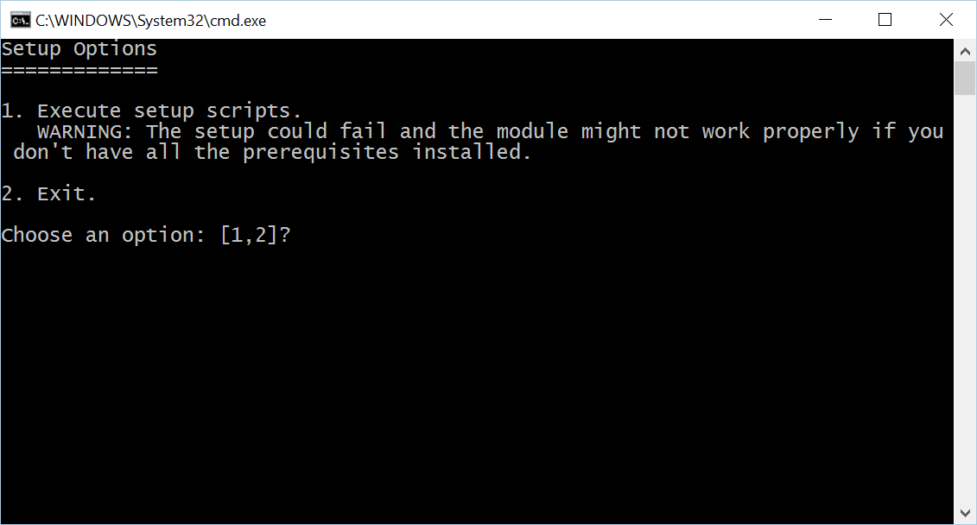
Install Code Snippets
Go to C:\Labs\CodeLabs-UWP\Workshop\Module1-AdaptiveUI\Source
Right-click on Setup.cmd, click on Run as administrator
Click Yes at the User Account Control prompt
Select option 1 in the command window

Slide 14
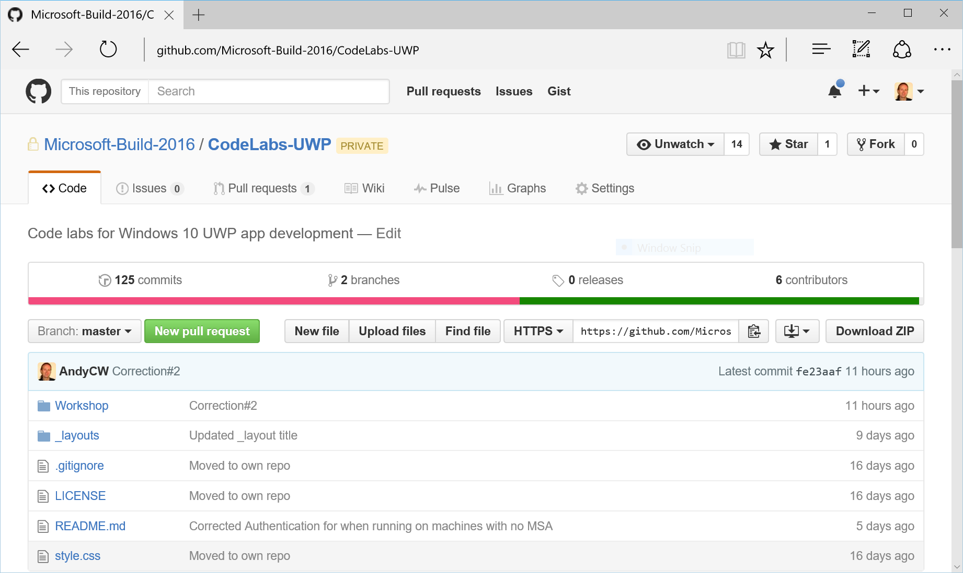
View lab manual
On your desktop, click the UWP CodeLabs icon to open the browser at the Github repository for these labs: https://github.com/Microsoft-Build-2016/CodeLabs-UWP
Click on Workshop folder

Slide 15
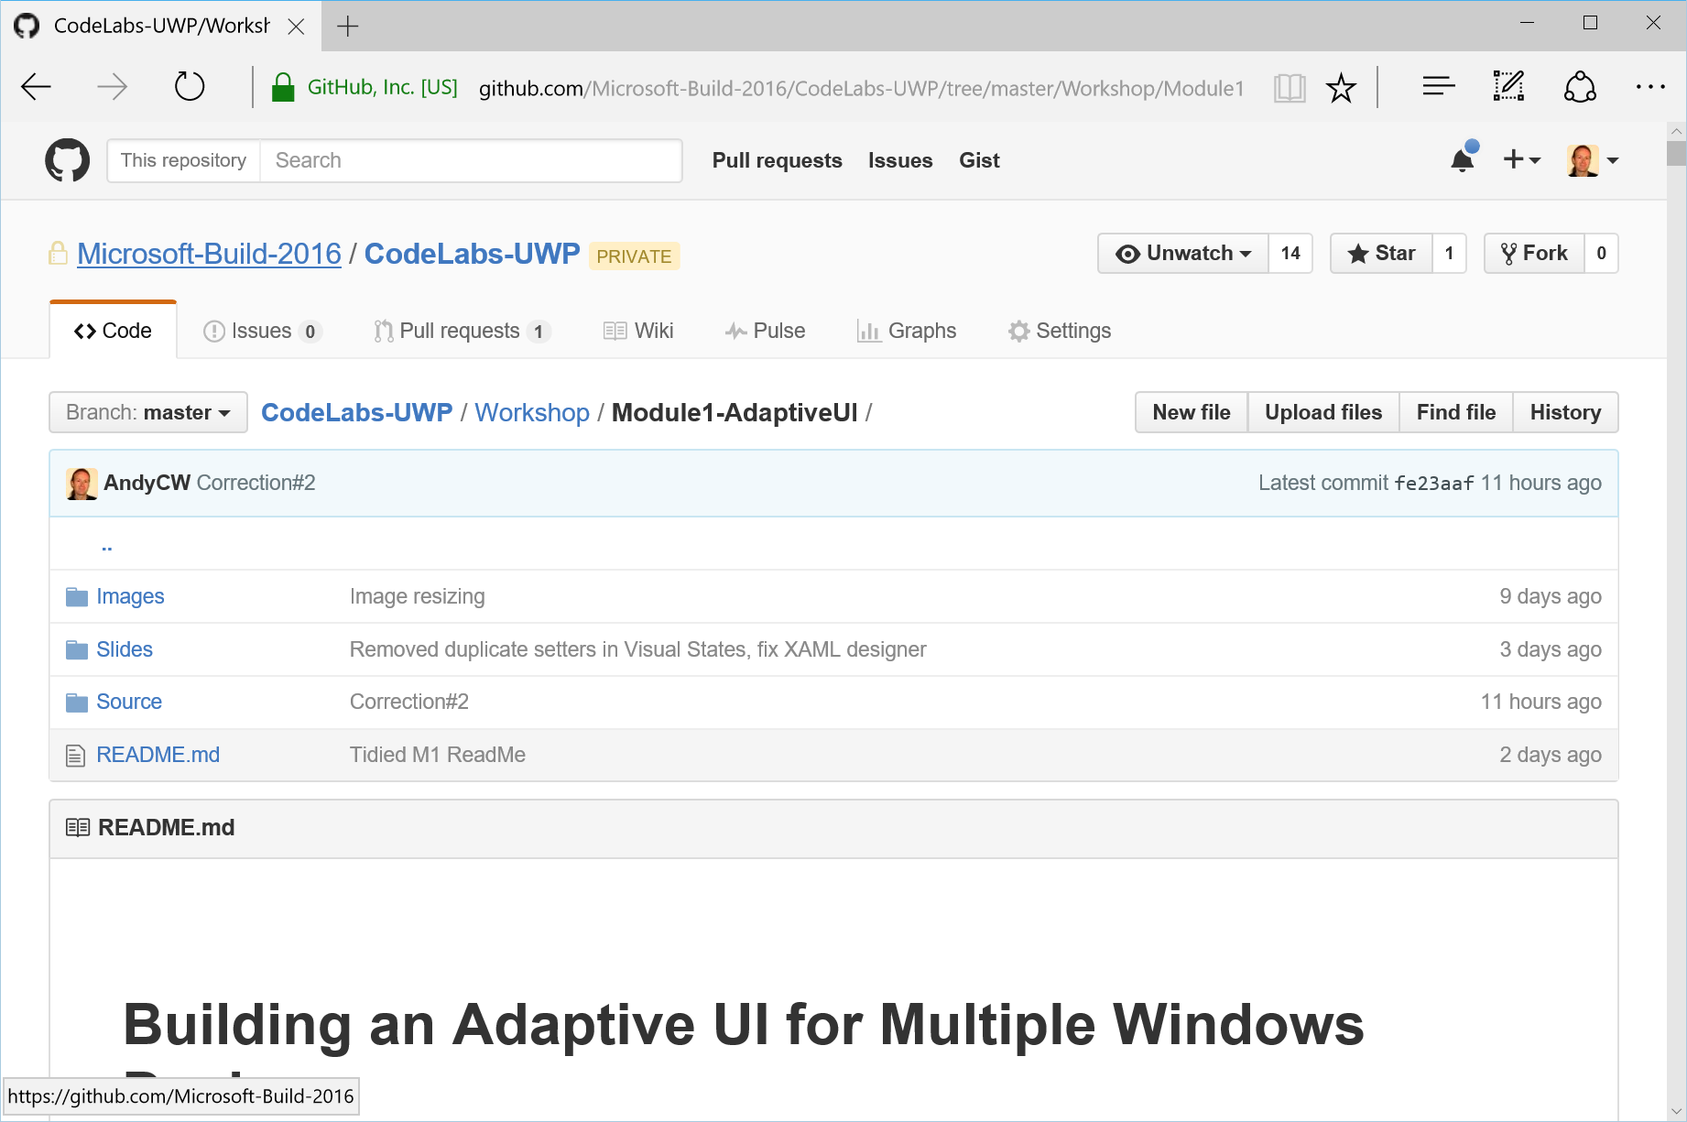
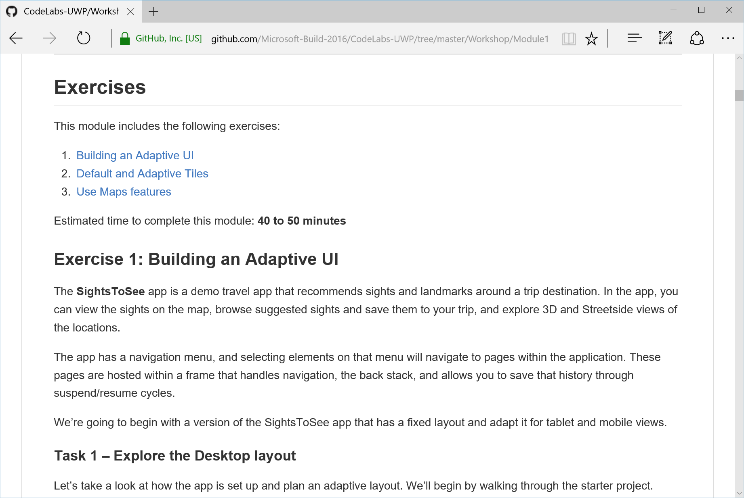
View lab manual
Click on the folder for the current module
Scroll down for the README.md – this is your lab manual

Slide 16
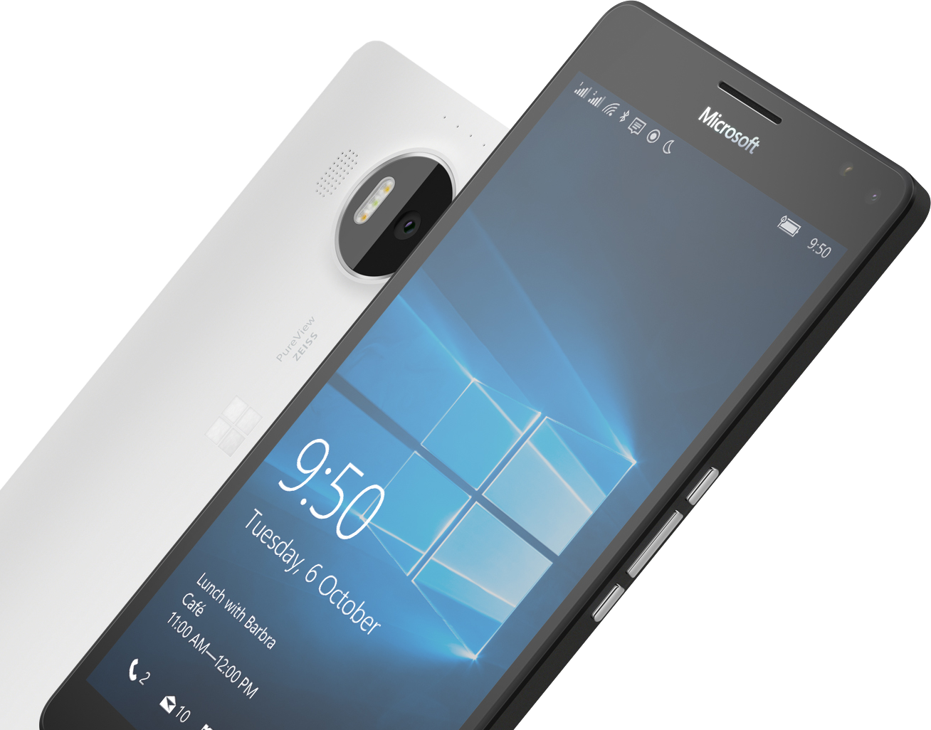
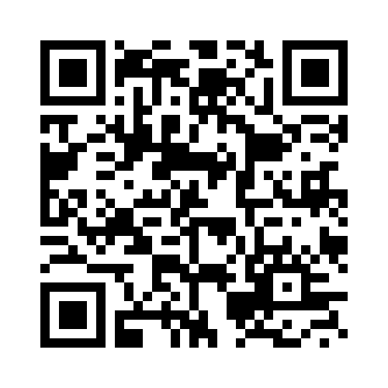
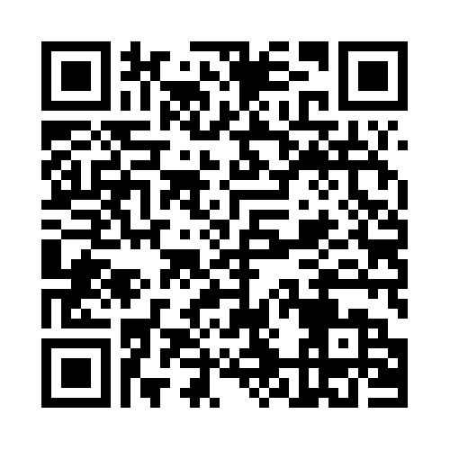

Please Complete An Evaluation Form Your input is important!
SAMPLE
or
Notes:
Update phone image to a Microsoft phone.

Slide 17
Evaluate this session
SAMPLE
Notes:
Speakers: Please note this slide will be updated with your session’s QR code during the scrub process which is outlined on side 3. Attendees can scan the QR code for access to your session’s eval.

